Slide 1
Model of a Robot Arm in Simulink
Manu Mejía 142406
Memo Flores 150951
Beto Salinas 149038

Slide 2
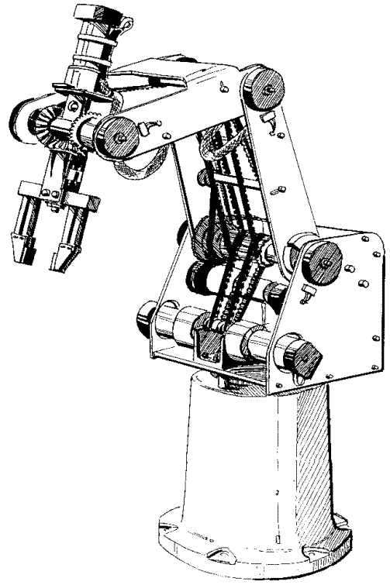

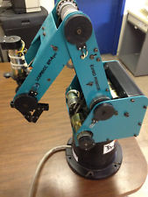
Robot design in NX version 10
Five main parts of the robot were designed to simulate its motion:
Base
Cube
Arm1
Arm2
Claw

Slide 3
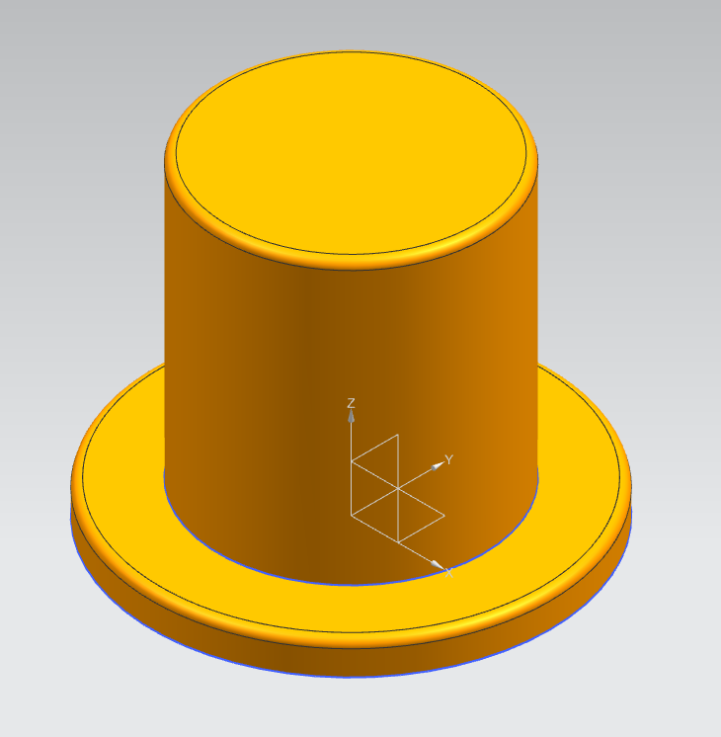
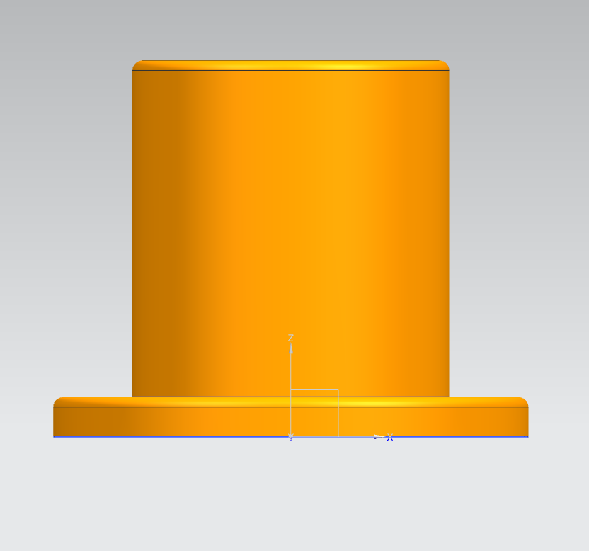
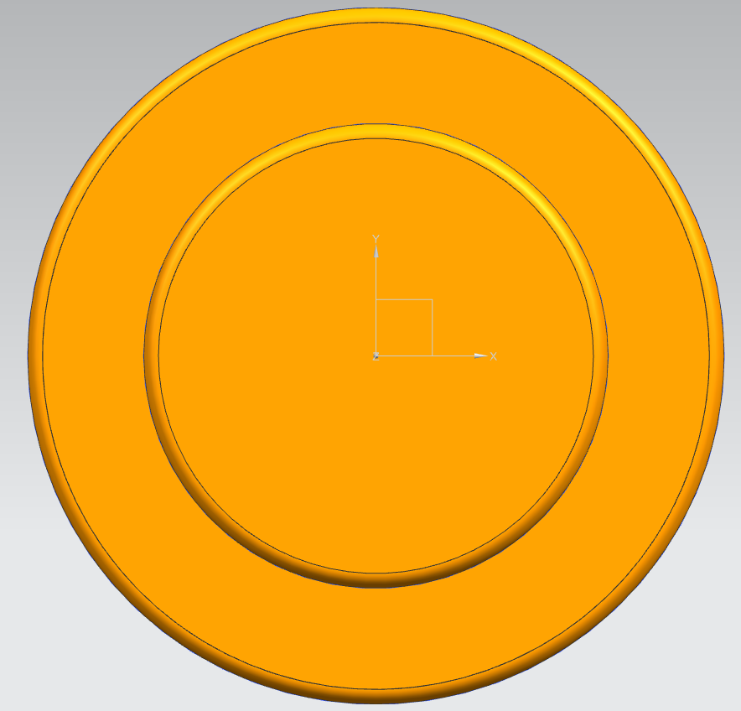
Base

Slide 4
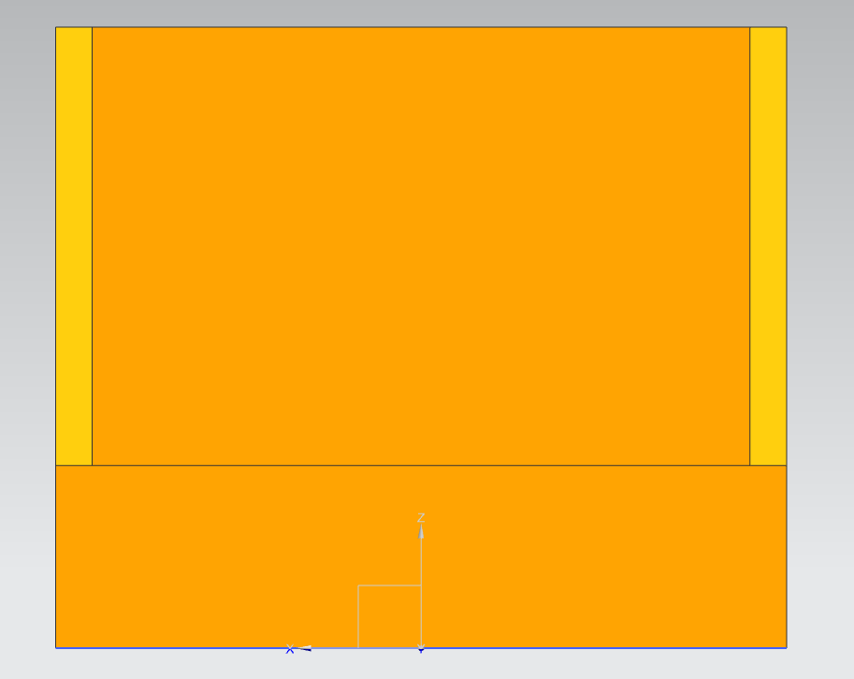
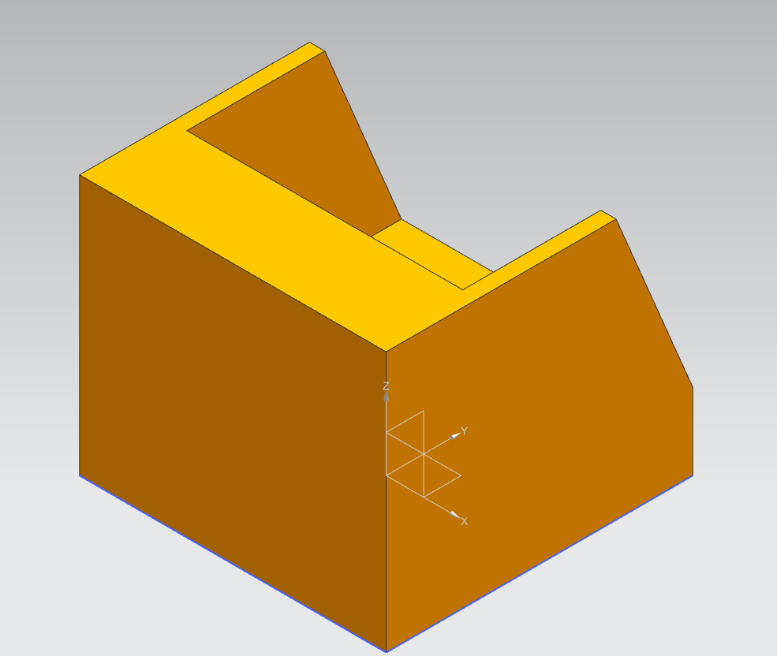
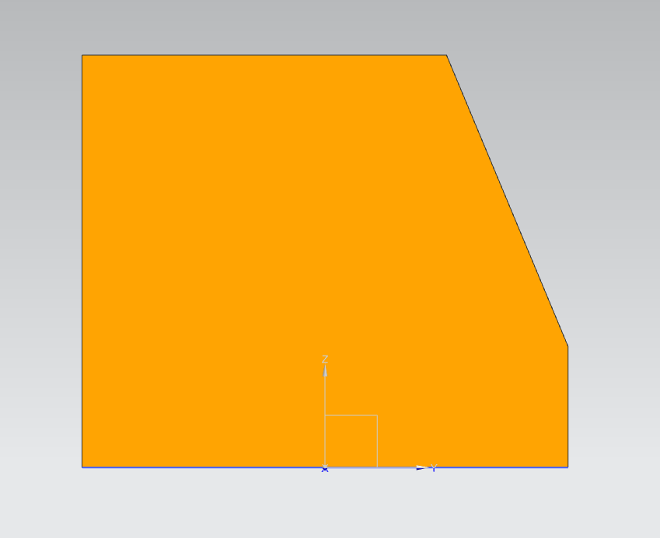
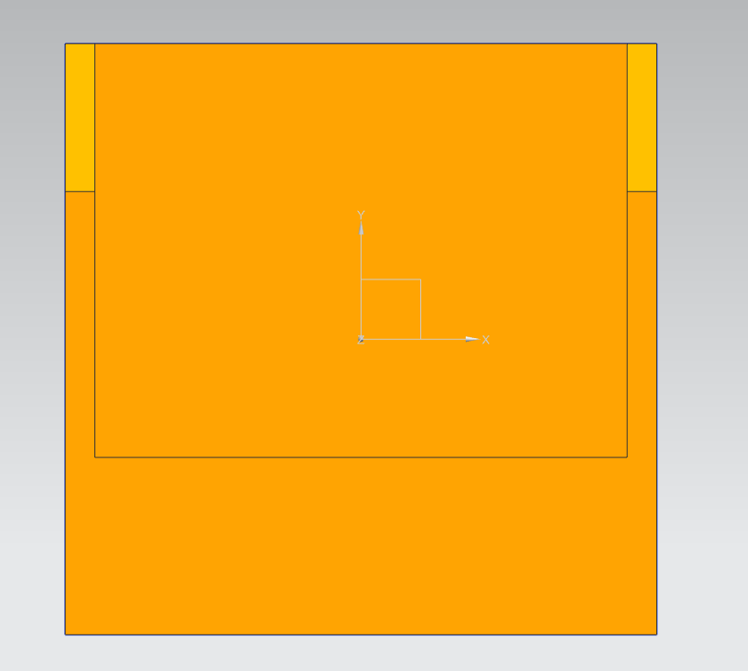
Cube

Slide 5
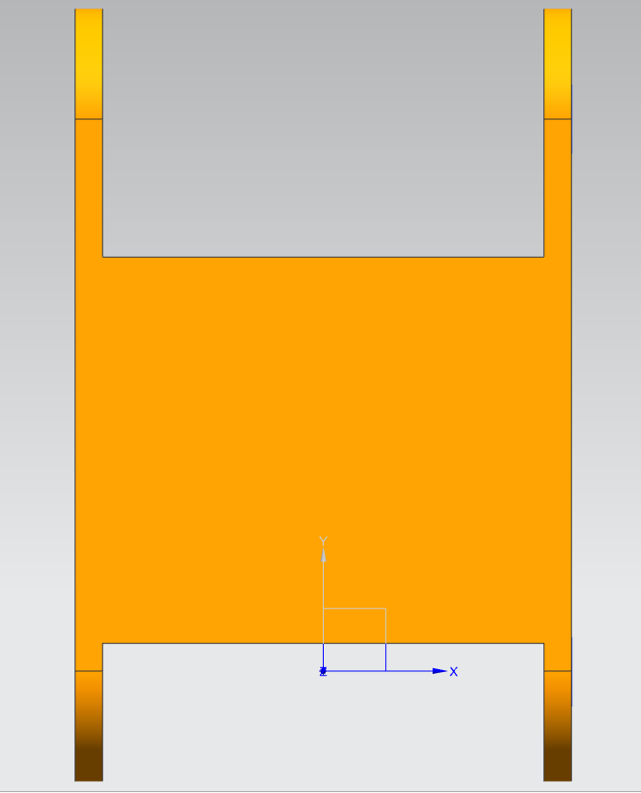
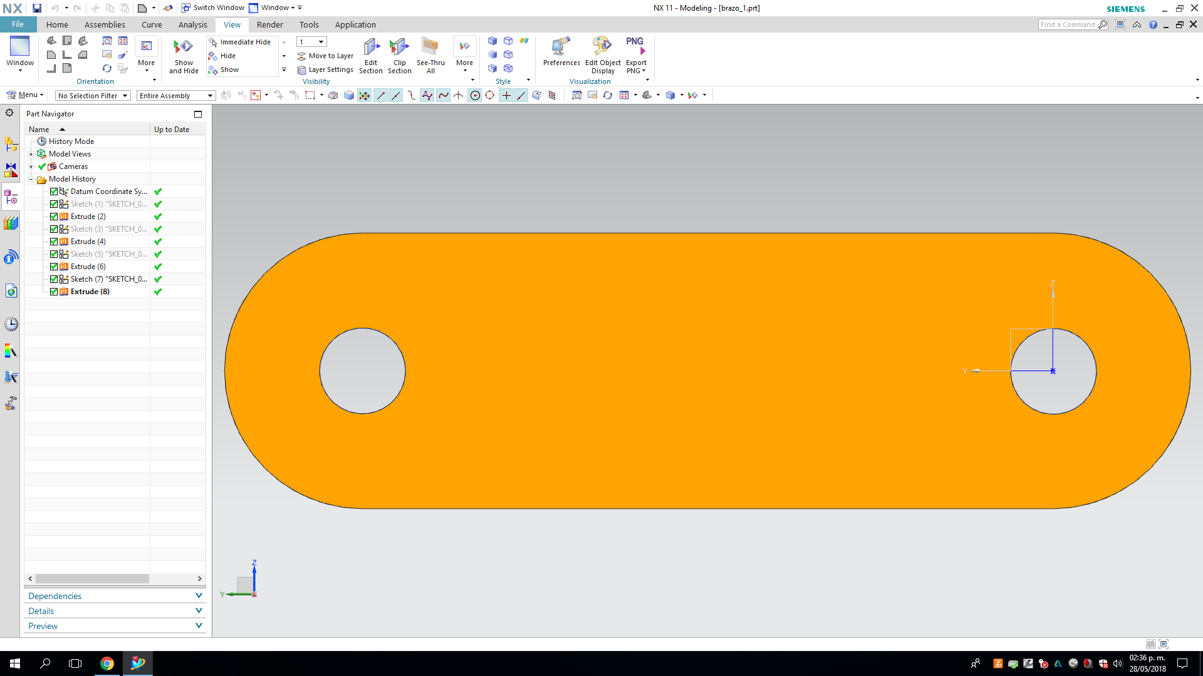
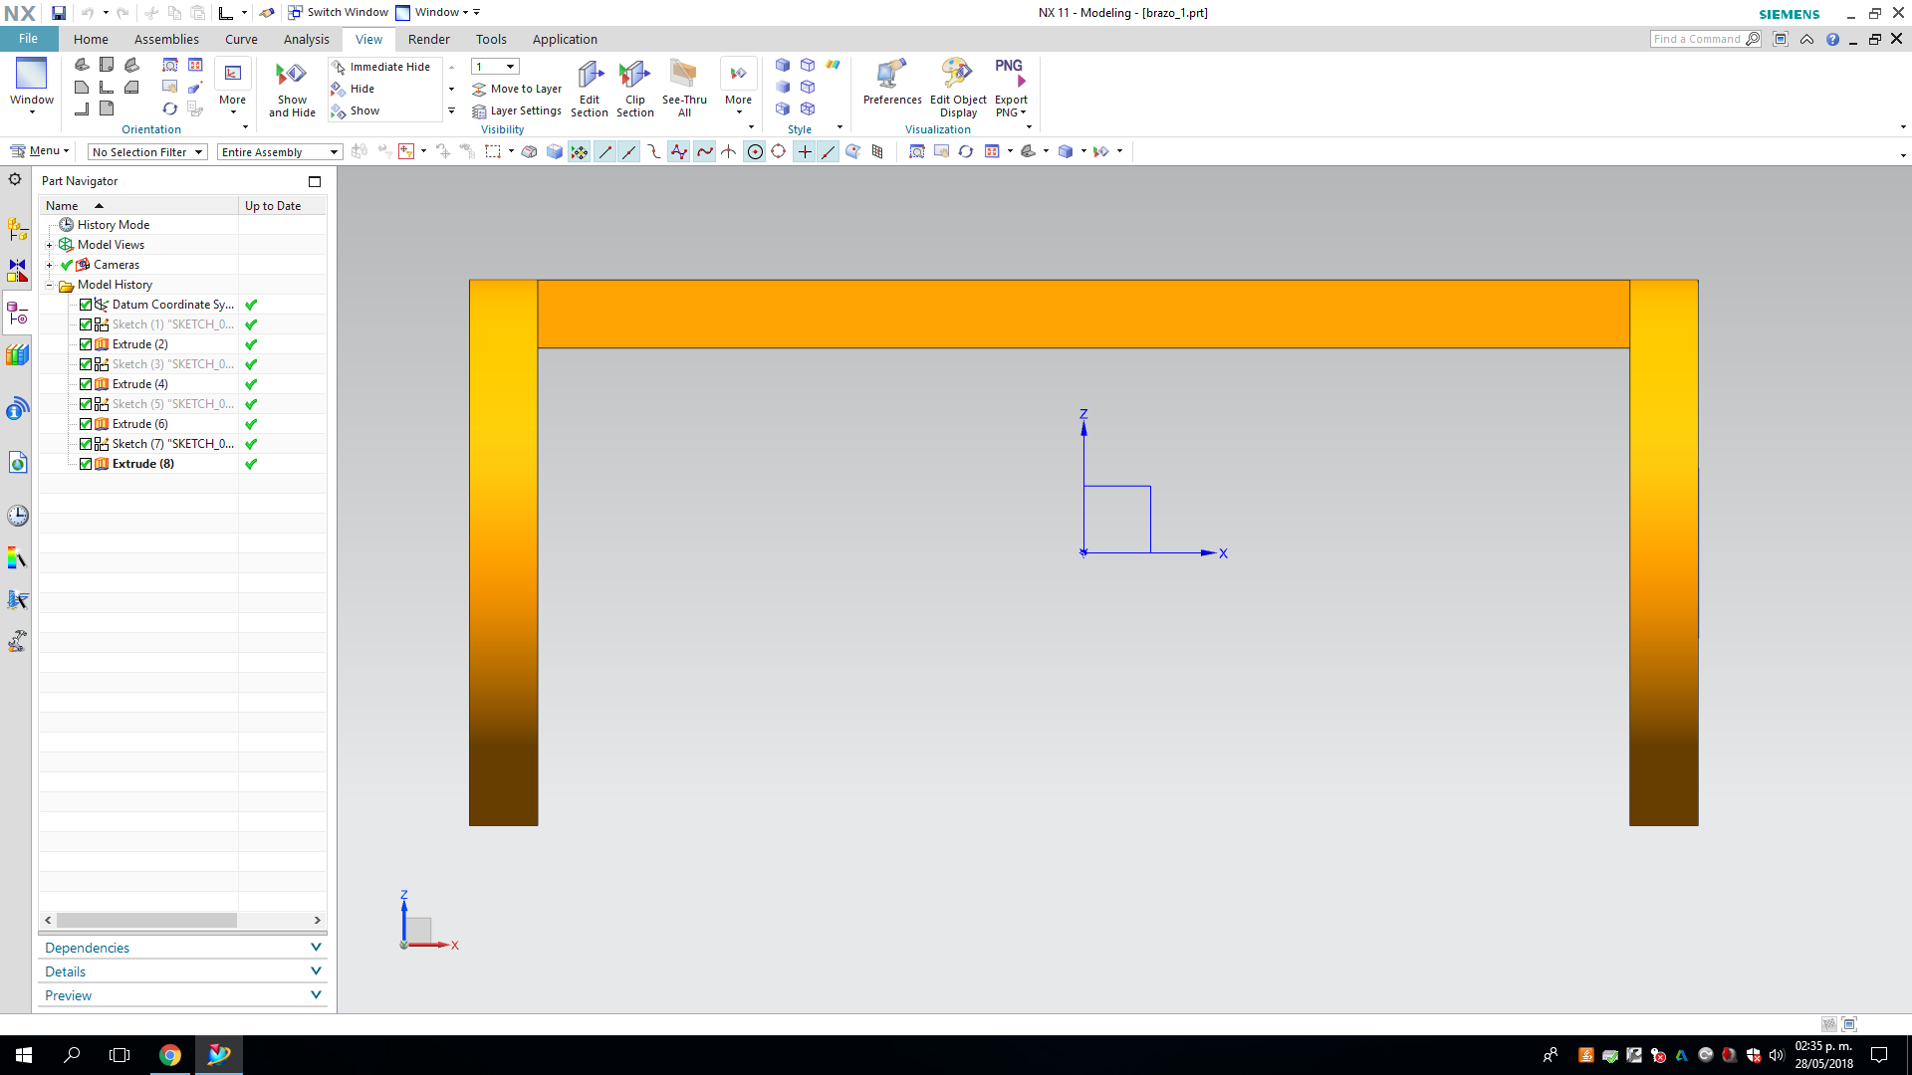
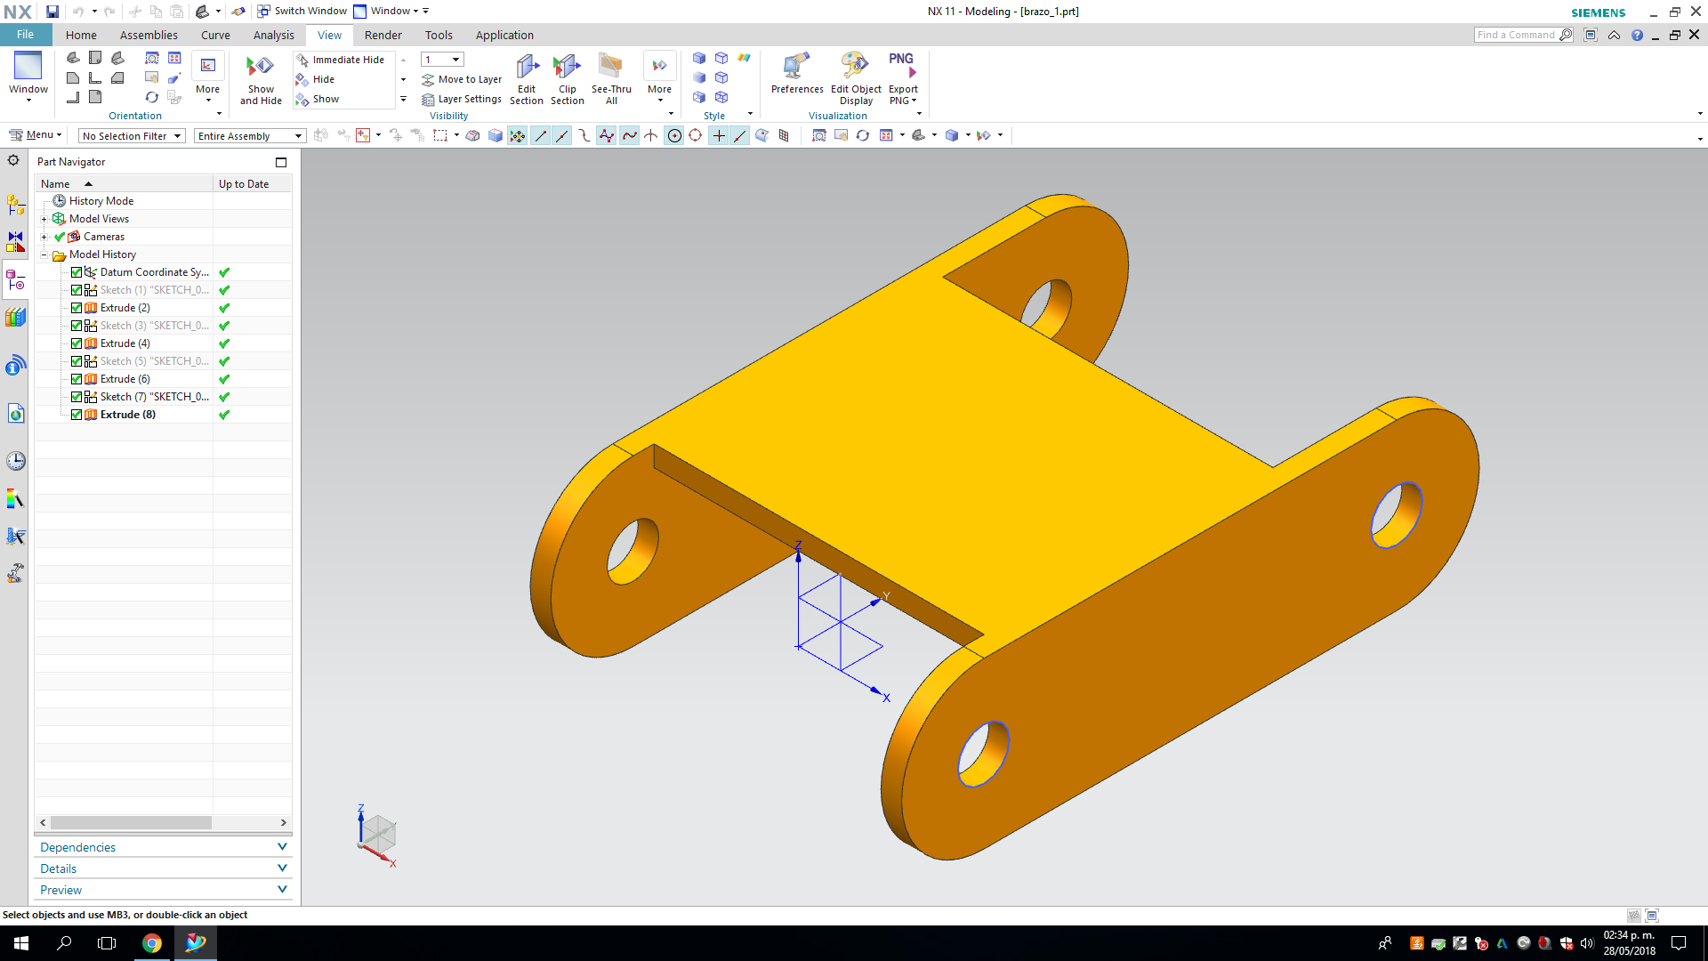
ARM1

Slide 6
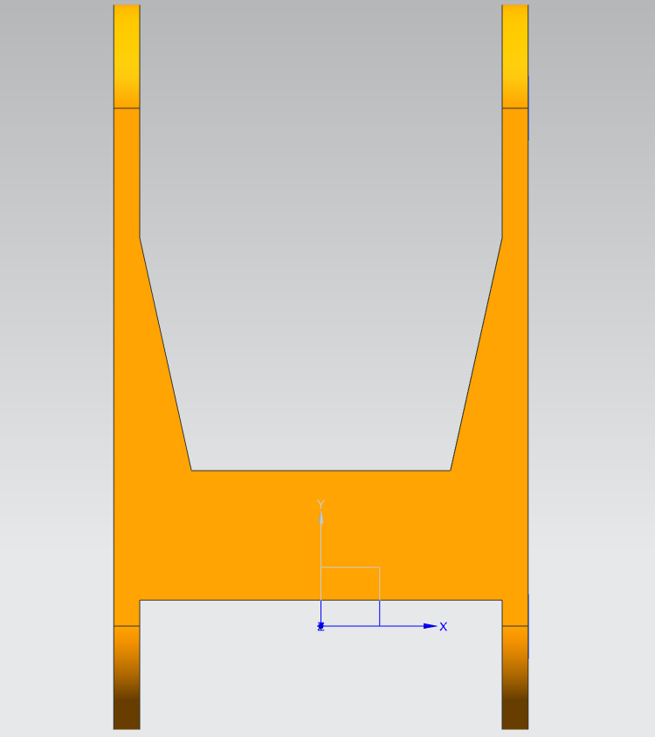
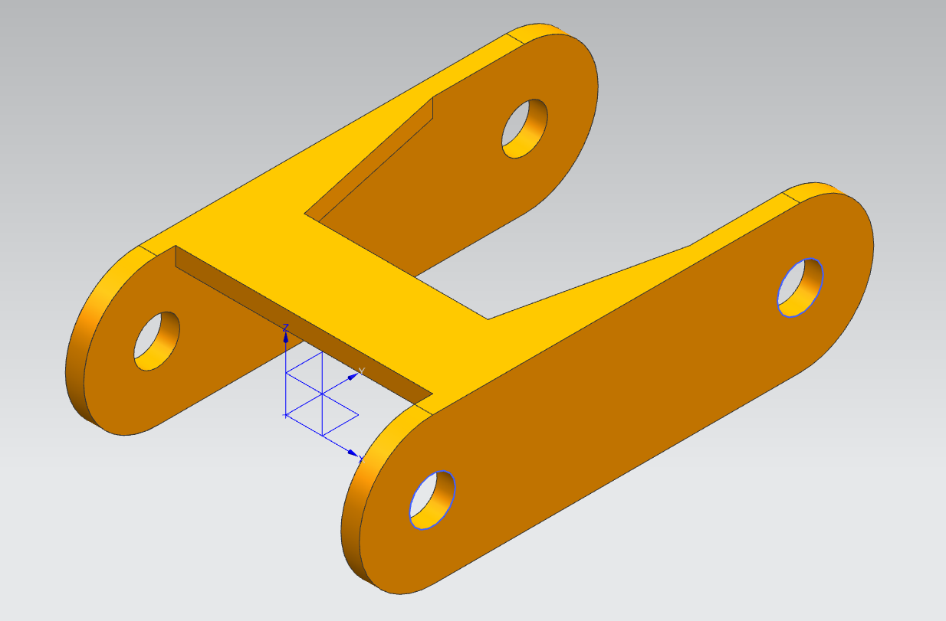
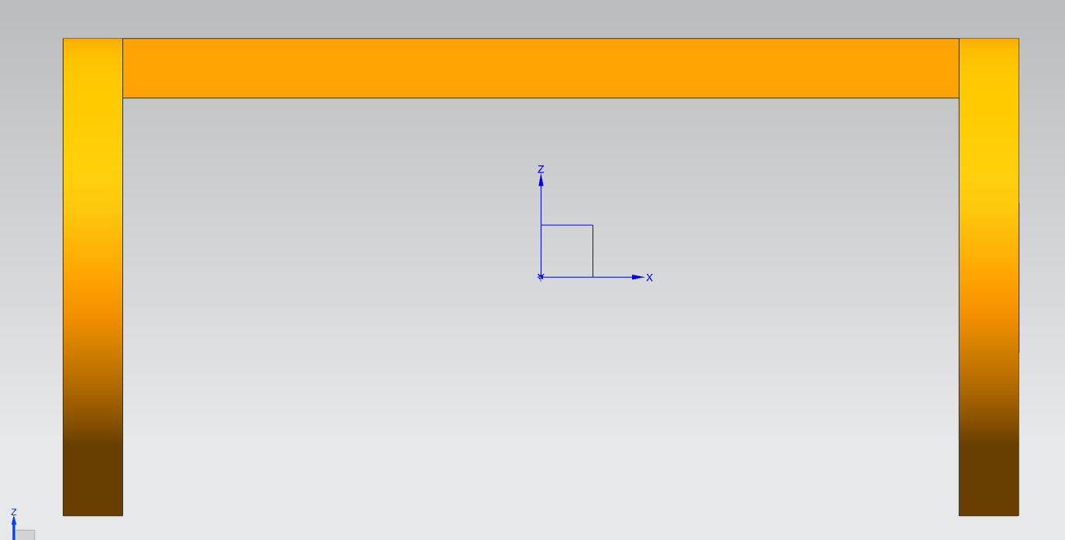
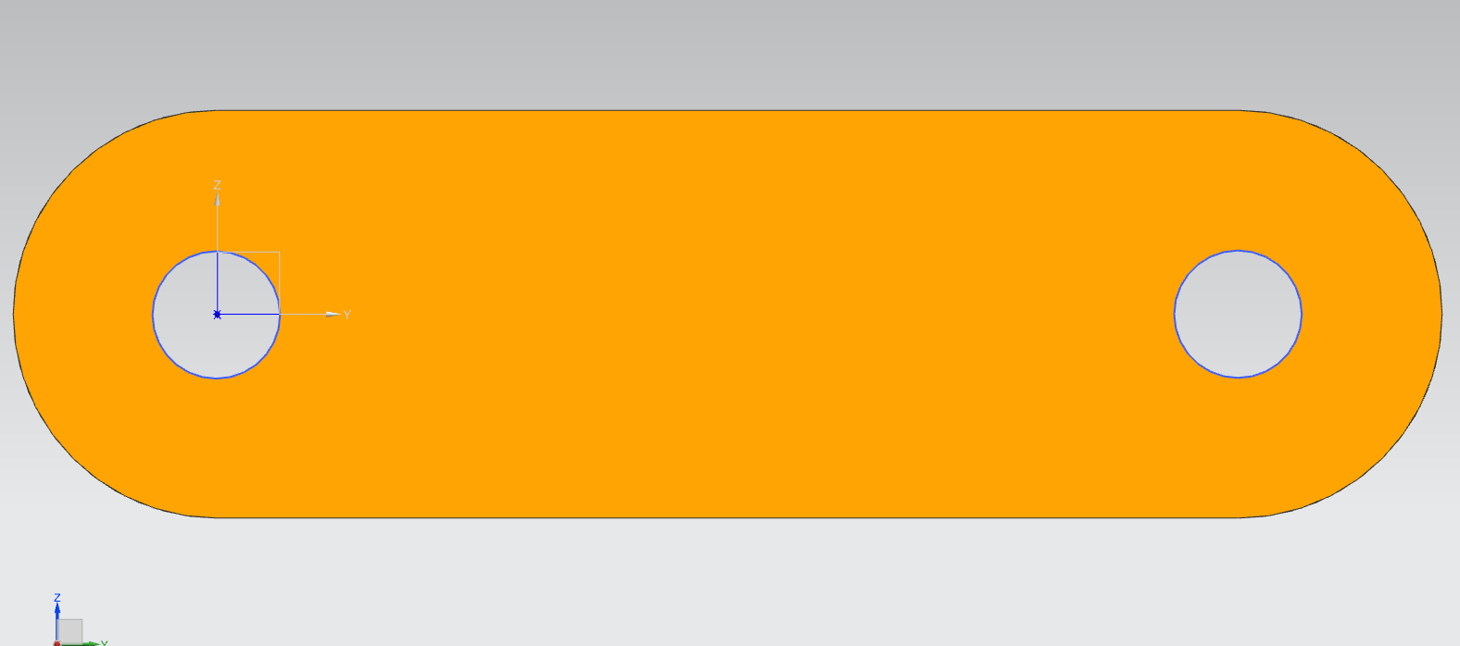
arm2

Slide 7
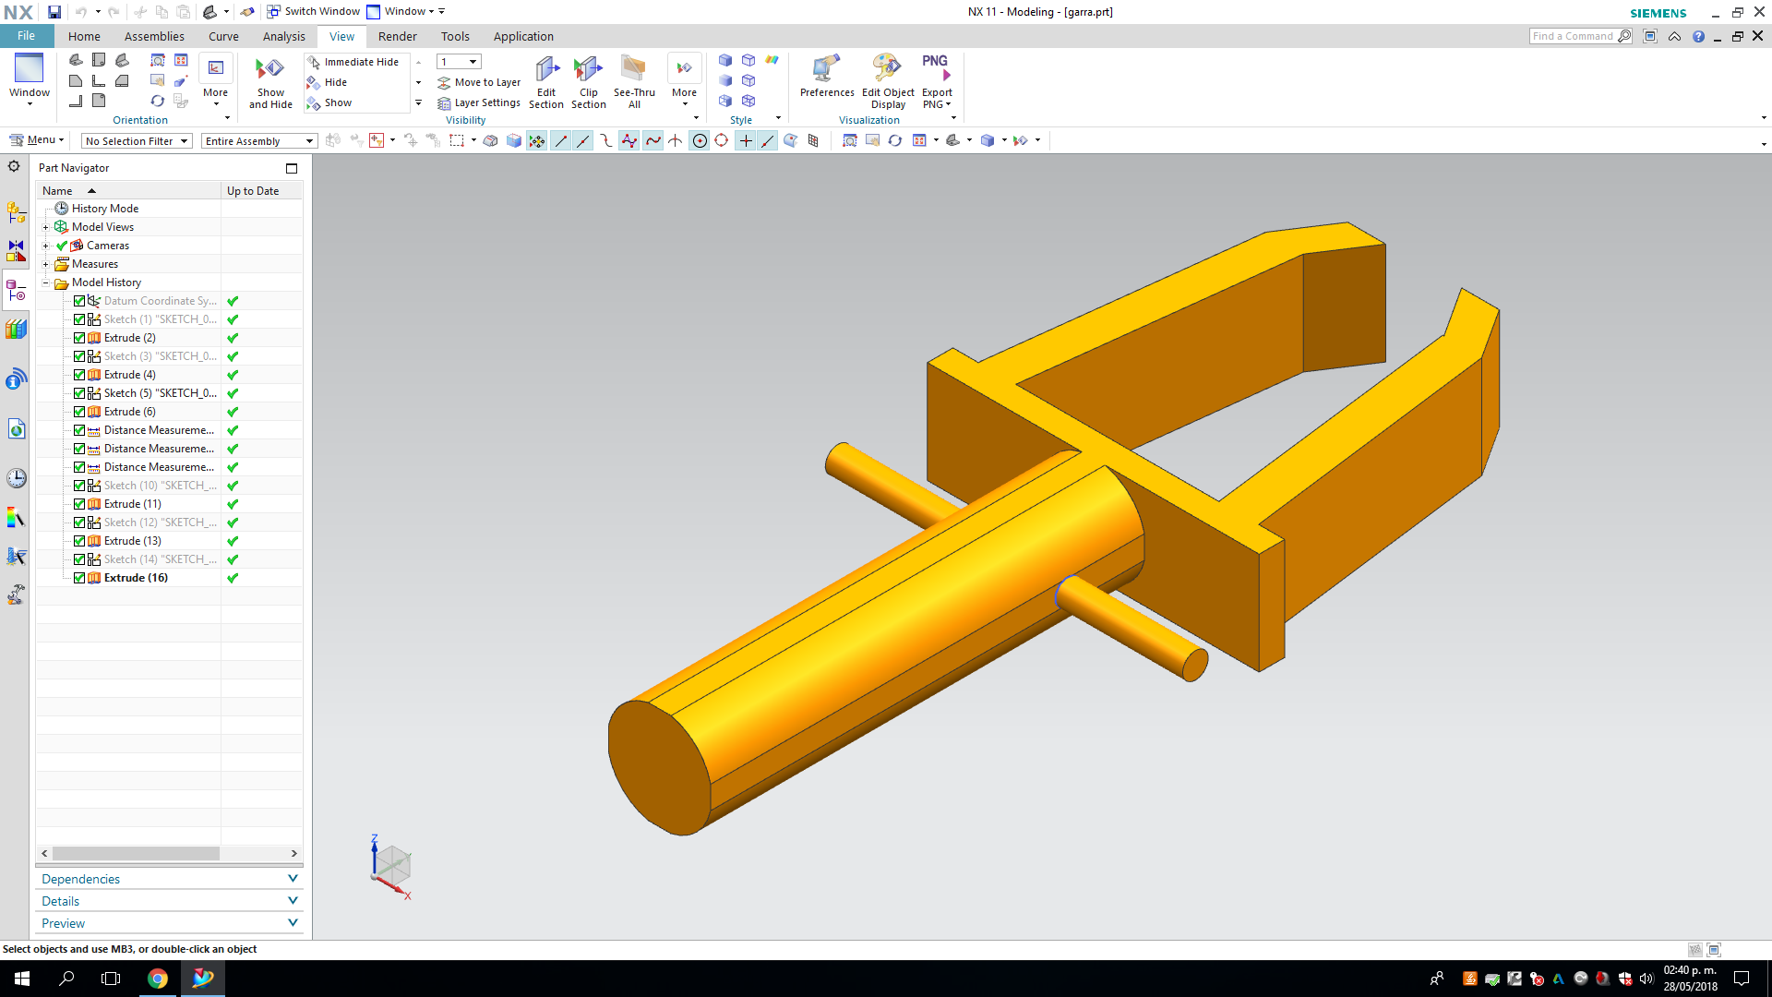
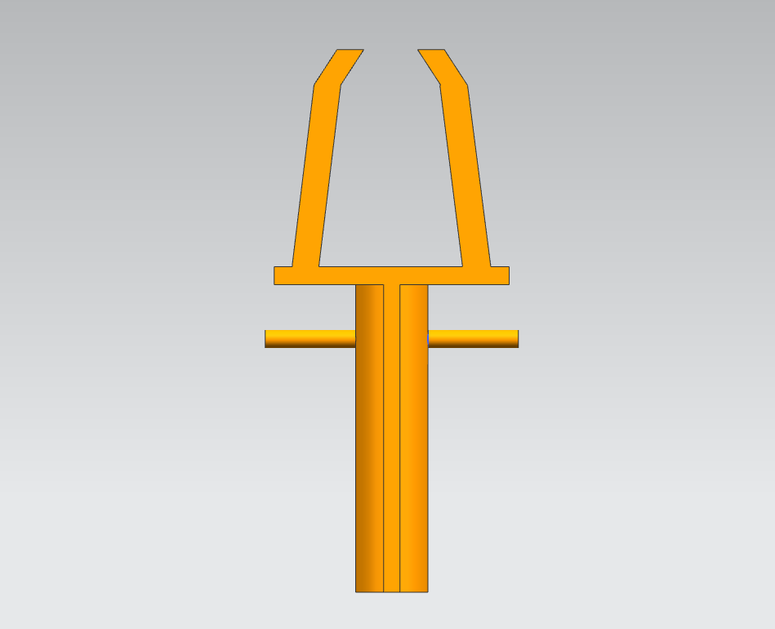
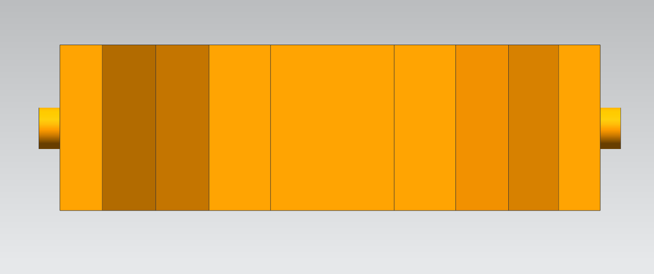
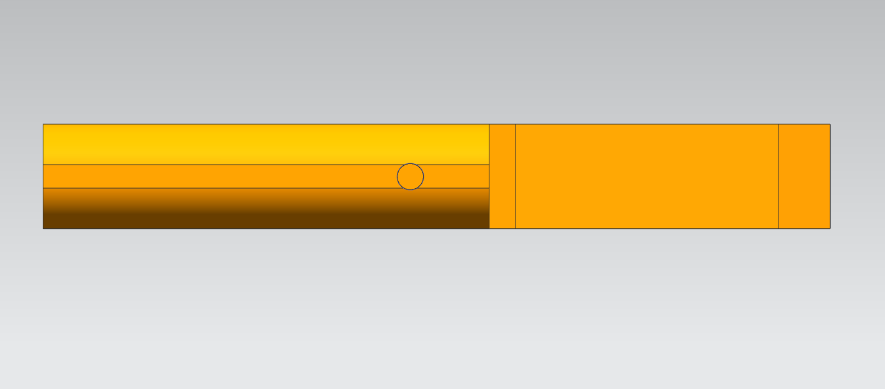
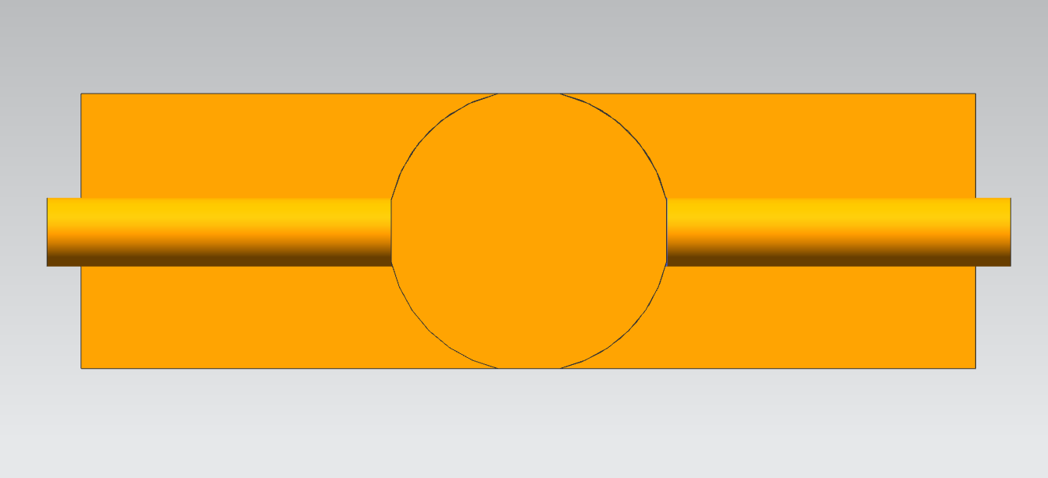
claw

Slide 8
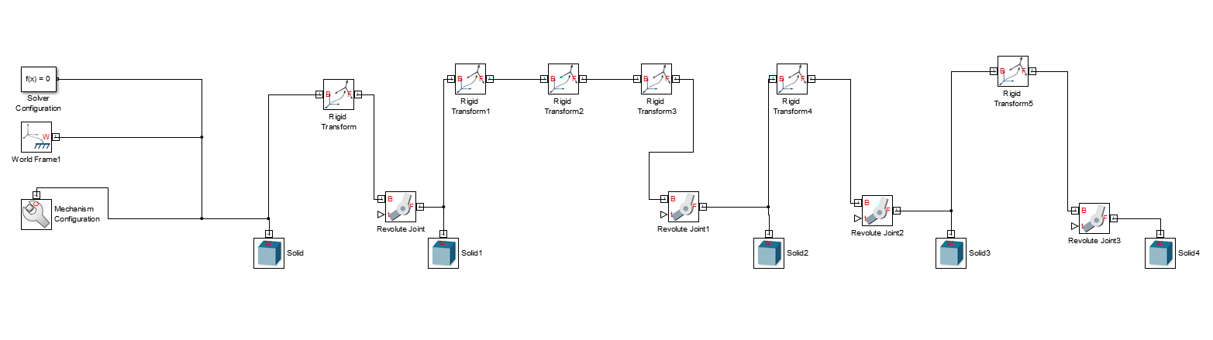
FROM NX to MATLAB

Slide 9
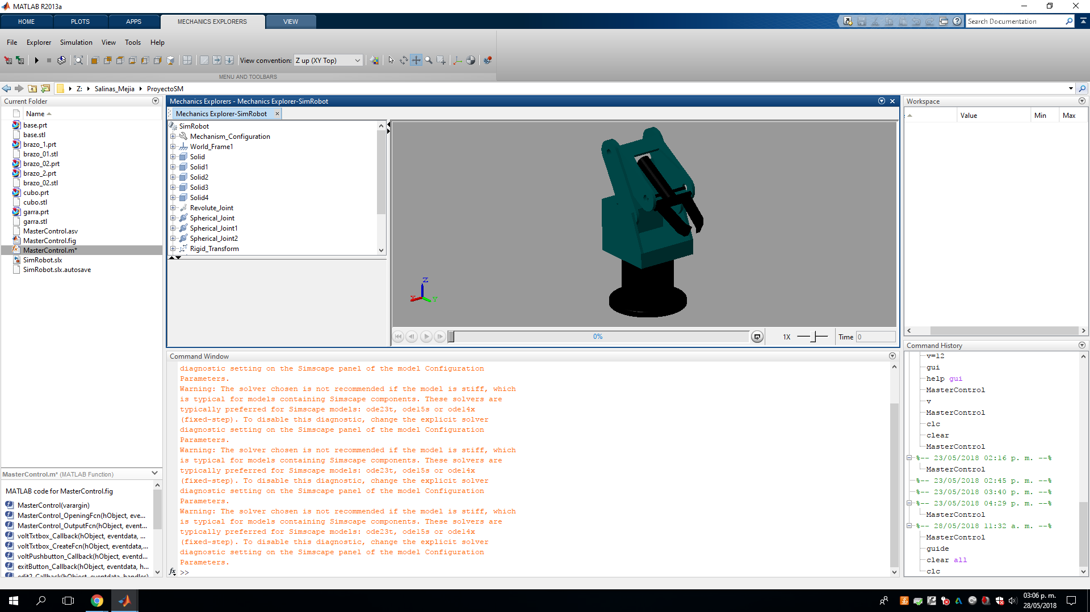
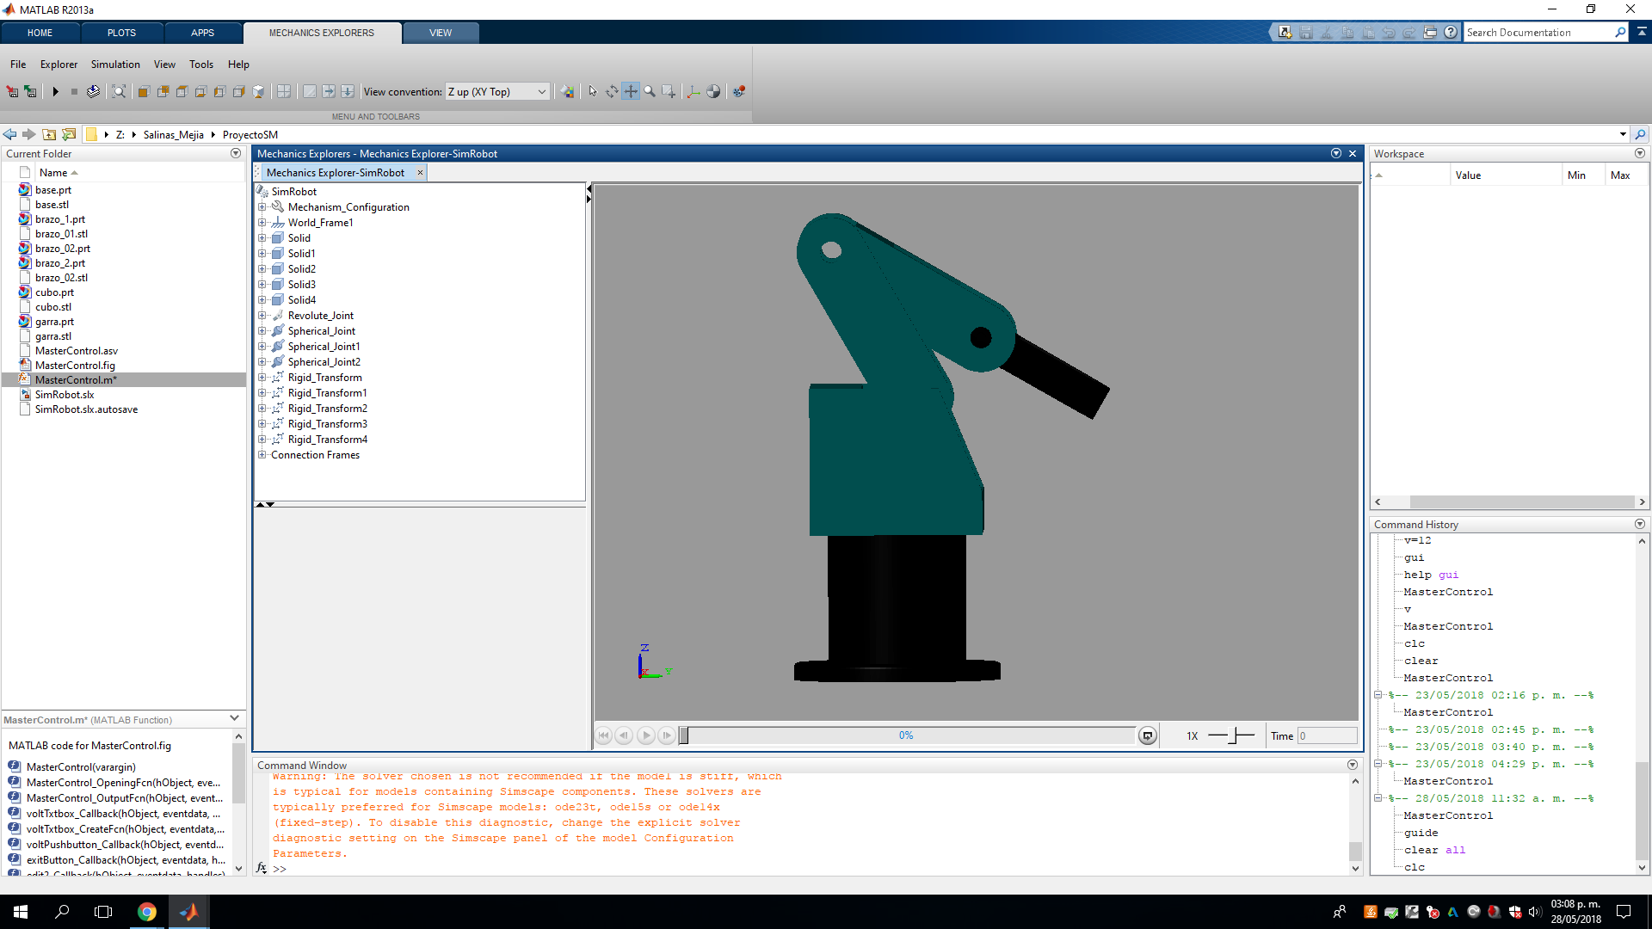
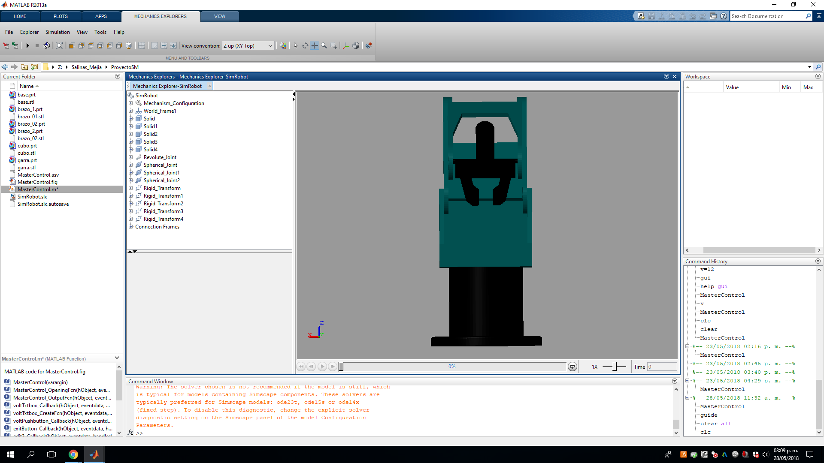
FROM NX TO MATLAB

Slide 10
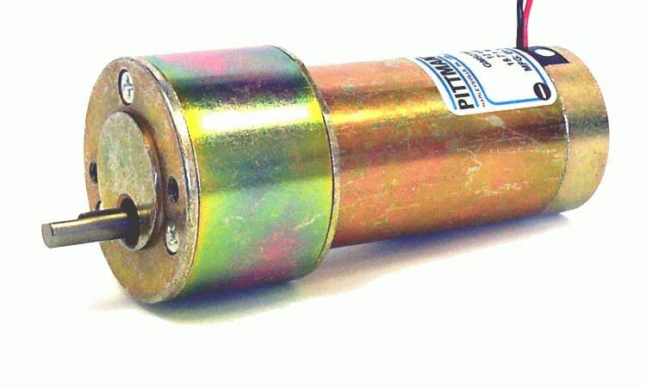
MODELING A DC MOTOR IN SIMULINK

Slide 11
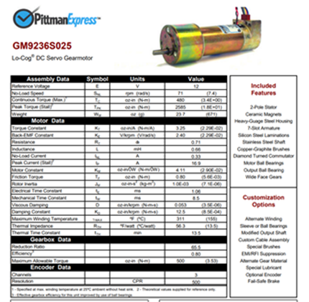
Datasheet
http://www.gearseds.com/files/GM9236S025.pdf

Slide 12
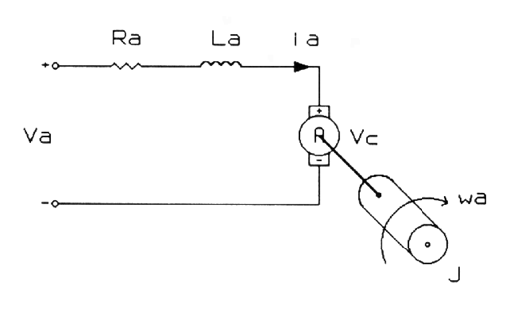
DC Motor Equations
Vs= RiL(t) + Ldi(t)/dt + VB (EMF)
VB= KB * w(t)
T= KT * i(t)
T= IL * dw(t)/dt
KT*i(t) = IL * dw(t)/dt
Vs=RiL(t) + L di(t)/dt + KB*w(t)
dw(t)/dt= KT/IL *i(t)
di(t)/dt = 1/L * [Vs – Ri(t) – KB w(t)]
Integrating the upper differential equations we can obtain w (angular velocity)
and i (current).

Slide 13
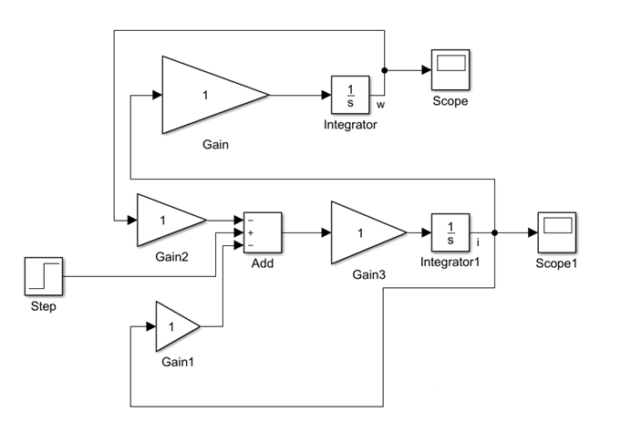
Simulink Model

Slide 14
Parameters for the Simulink Model
KT = 2.29e-2 [N-m/A]
KB = 2.29e-2 [V/rad/s]
R = 0.71 [Ohms]
L = 0.66 [mH]
IL = 7.1e-6 [kg-m^2]

Slide 15
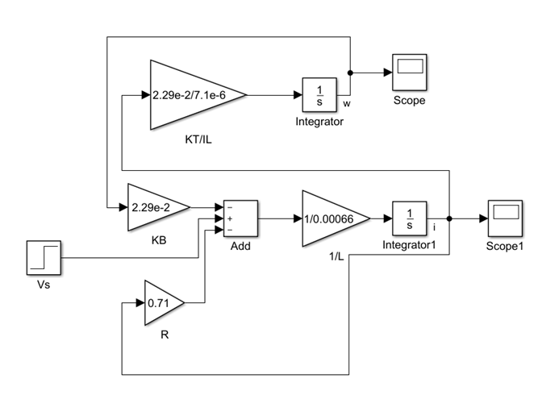
Simulink Model with Parameters

Slide 16
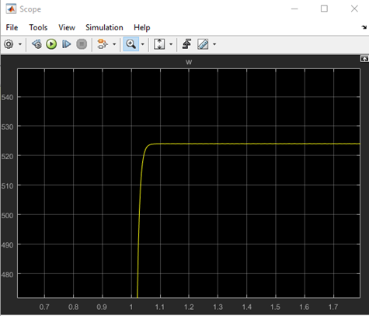
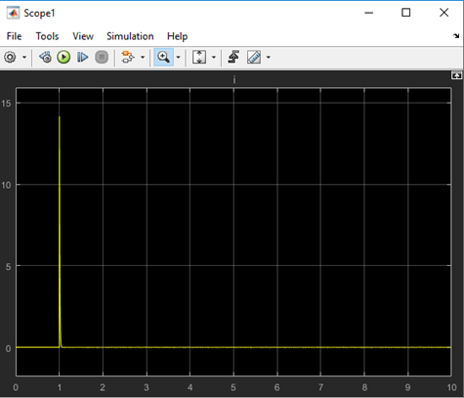
Angular velocity and current (w, i)

Slide 17
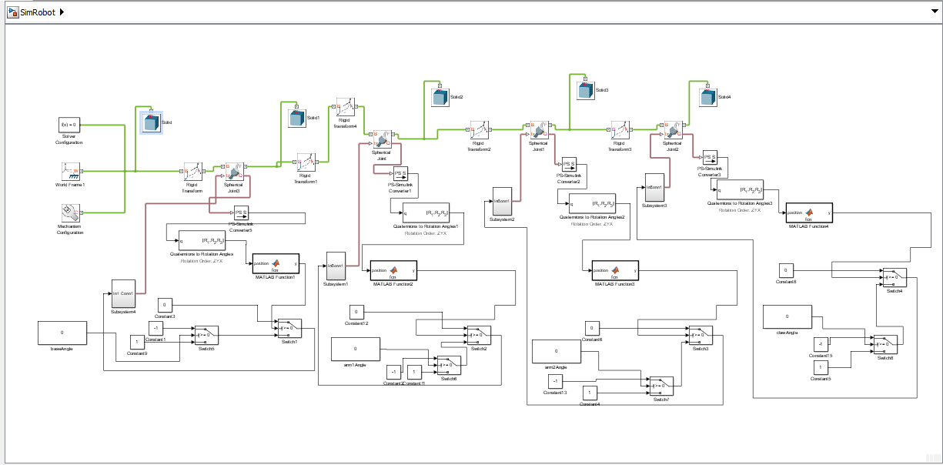
Scorbot-er 4pc in simulink

Slide 18
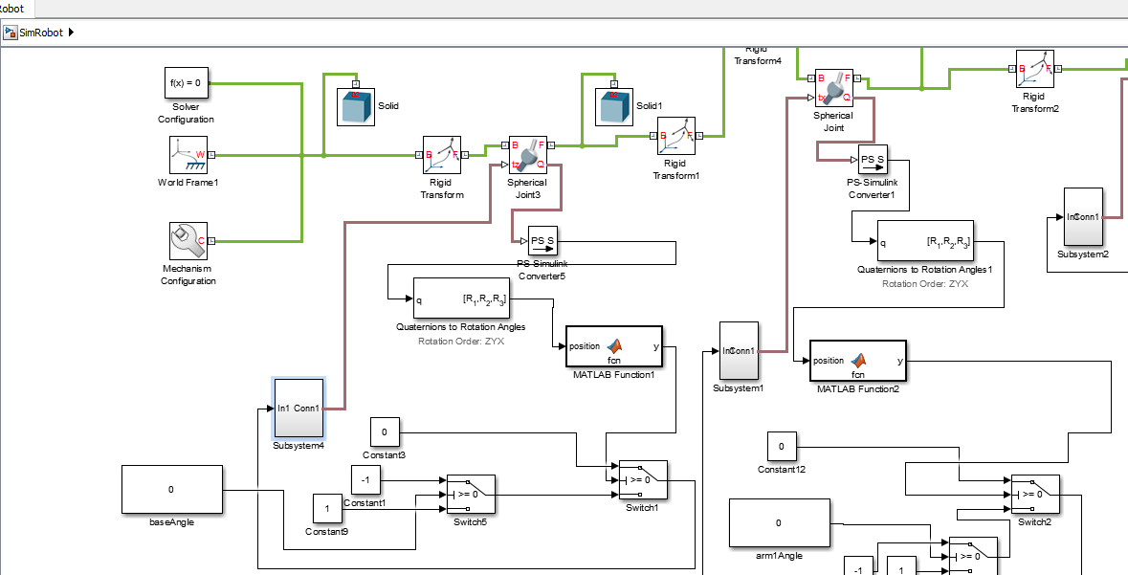
Control of the model

Slide 19
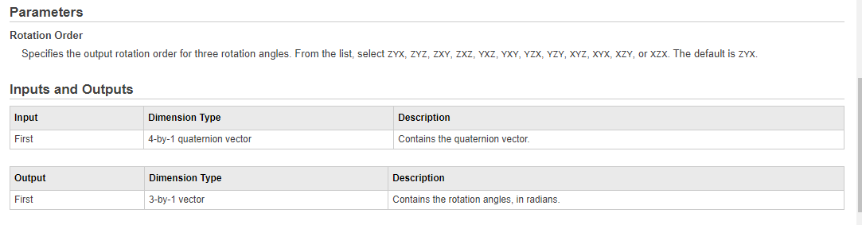
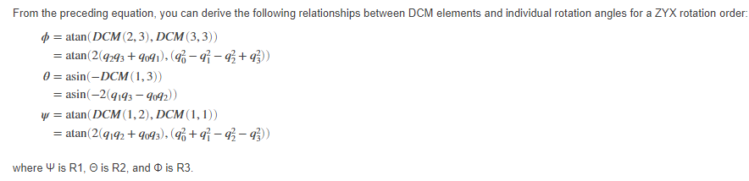
TECHNICAL INFORMATION

Slide 20
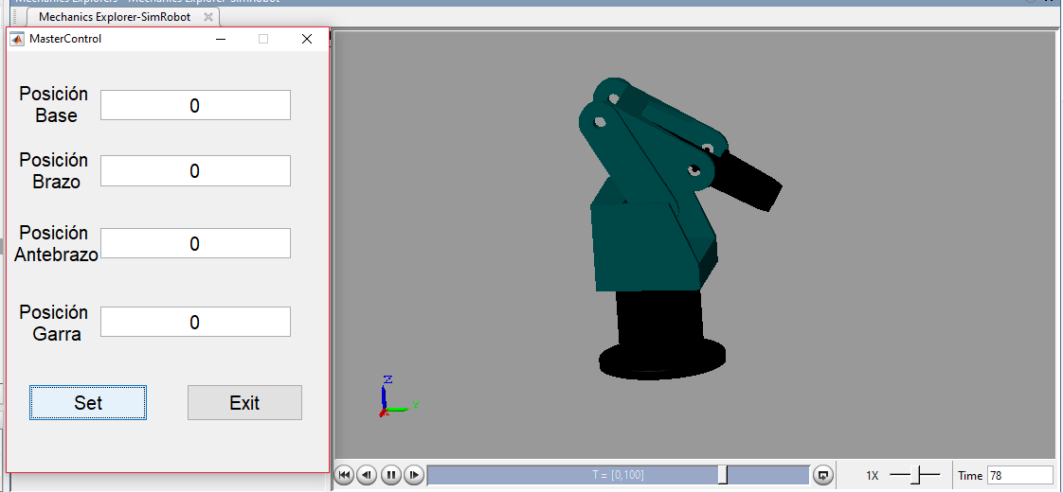
GUI IN MATLAB

Slide 21
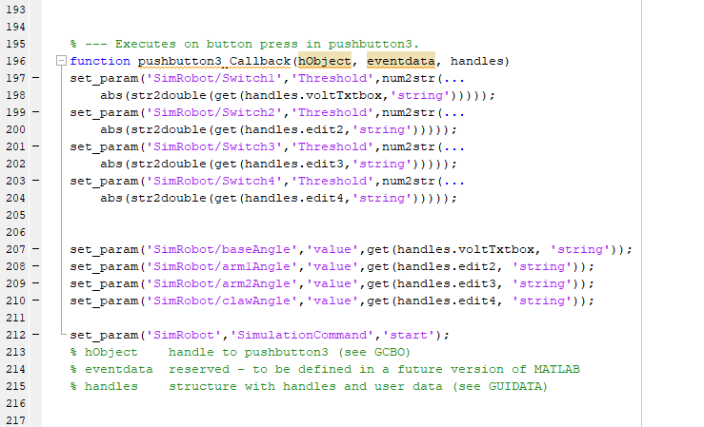
GUI IMPORTANT CODE

Slide 22
POSSIBLE IMPROVEMENTS
MODIFY VALUES WHILE RUNNING THE MODEL WITH THE USE OF DASHBOARD SIMULINK BLOCK
SIMULATE GRAB MOTION OF CLAW
SOLID CONSTRAINTS
ADD GRAVITY
ADD GEARS

Slide 23
Roles
NX 10 : Alberto y Abraham
Motor: Guillermo y Alberto
Control: All
GUI: Abraham y Guillermo

Slide 24
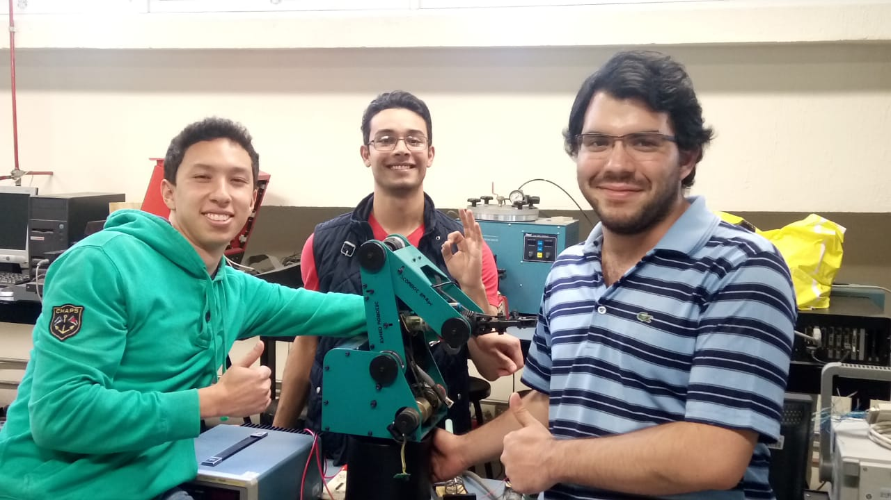

Gracias

